Slide 1
Seeking Statement-Supporting top-K Witnesses
Date: 2012/03/12
Source: Steffen Metzger (CIKM’11)
Speaker: Er-gang Liu
Advisor: Dr. Jia-ling Koh

Slide 2
Outline
Introduction
Statement Search
Witness
Dictionary
Indices
WITNESS RETRIEVAL AND RANKING
Experiment
Conclusion

Slide 3
Motivation
“ Barack Obama was born in Kenya ”
Keyword search:
“Obama” and “Kenya”
Statement search:
“Barack Obama was born in Kenya”
“ Barack Obama was born in Kenya ”
“ Obama visited Kenya on a diplomatic mission ”
“ Obama’s birthplace is Kenya ”
“Kenya, the birthplace of the first African-American president ”

Slide 4
Introduction
Motivation:
Information retrieval (IR) is traditionally based on keyword search. And system aims not only for exact matches of the given keywords but also for semantically similar keywords.
Goal:
Notion of statement search and proposes a framework that enables semantic-aware document retrieval by mapping user queries to semantic statements and retrieving witness documents expressing these statements in different textual forms.
EX: “Barack Obama was born in Kenya”
“Obama spent his childhood in Kenya”
“Kenya, the birthplace of the first African-American president”

Slide 5
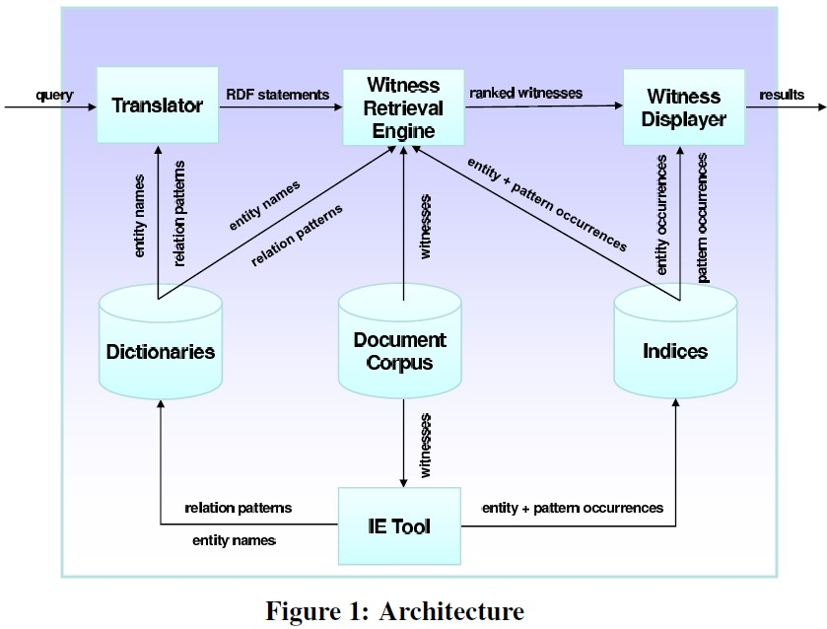
Introduction – System Architecture
“ Barack Obama was born in Kenya ”
(Obama, bornIn, Kenya)
(X was born in Y , 2)
(X is leader of Y , 3)
……
“X was born in Y”
“X is leader of Y ”
…..
(Barack Obama ,5)
(Kenya,2)
……
“ Barack Obama ”
“Kenya”
…..
Information Extraction

Slide 6
STATEMENT SEARCH
User might want to verify whether a certain statement is true, and seek documents confirming this statement . (persuasiveness)
EX: Barack Obama was whether born in Kenya ?
User might want to investigate a certain statement and find more details about it. (on-topicness)
EX: User know “Osama Bin Laden died on May 2011” . But wants to find more details about his death.
Example:
The Wikipedia article about the Kapiolani Medical Center in Honolulu might clearly state that Obama was born there.
A blog post discussing Obama’s childhood could provide more information about the president’s youth.

Slide 7
Witness
Phrase query ：“Barack Obama was born in Kenya”
RDF knowledge bases consist of statements in the form of subject-property-object triples.
Subject : Barack_Obama
Object : Kenya
Property / Relation : bornIn
RDF triple : (Barack_Obama , bornIn , Kenya)
Entity : Obama 、Kenya
S = entity (Obama , d1)
O = entity (Kenya , d1 )
Indicates( P, bornIn)
P( Obama , Kenya )
Pattern instance (“ X was born in Y” )
d1
“Barack Obama was born in Kenya”

Slide 8
Quality of Witness
The quality of a witness is therefore based on the following features:
1)Statement frequency
Ex: D1 containing “Barack Obama was born in Kenya” 10 times . D2 containing 3 times. D1 should be ranked higher than D2 .
2) Pattern confidence
Ex: “Barack Obama was born in Kenya” should be preferred over a document stating “Obama spent his childhood in Kenya”. “
“ Kenya, the birthplace of Obama“
3) Entity occurrences
4) Page authority
Ex: The White House website > Blog page

Slide 9
Dictionaries
Entity dictionary
Assume:
Each entity name is uniquely addressing exactly one entity within a given document.
EX: Entity “Barack_Obama “ can be represented by the names “Obama”, “Barack Hussein Obama”, “the US President”, etc
The disambiguation is solved externally and a mapping from entity names to the entity they refer to is given.
EX: Entity “Obama” might refer to President Barack_Obama or to his father Barack_Obama_Sr

Slide 10
Dictionaries
Relation Dictionary
The relation “ bornIn” can be expressed using the following patterns: “X was born in Y”, “Y, the birthplace of X”
The phrase “Obama’s home country Kenya” could refer to the fact
Barack Obama has family roots in Kenya (Barack_Obama, hasAncestorsFrom, Kenya)
He was born (bornIn) in Kenya (Obama, bornIn, Kenya)
PATTERN CONFIDENCE
The phrase “Obama’s home country Kenya”
(Barack_Obama, hasAncestorsFrom, Kenya) = 0.9
(Obama, bornIn, Kenya) = 0.75

Slide 11
Indices
Stores the number of times a certain pattern is instantiated with certain arguments in a document.
EX : (Barack_Obama,bornIn, Kenya )
The index would store that pattern “X was born in Y” appears with “Obama” and “Kenya”.
The second index deals with entities and stores for each document d the number of times an entity is mentioned in d.
d1
d1
“X was born in Y”, 1
“Y, the birthplace of X” , 1
“ X is leader of Y ” , 1
“ X died on Y ” , 4
“ X died in Y ” , 3
“JFK” , 5
“1963-11-22” , 3
“Dallas” , 6
“David Beckham” , 2
“ England” , 2

Slide 12
WITNESS RETRIEVAL AND RANKING
Query = { (JFK, diedOn, 1963-11-22), (JFK, diedIn, Dallas) }
Smoothing:
t1
t2
P(t1,t2 | d1) = $\frac{2}{4 }∗$ $\frac{1}{4 }$
t1, t1, t2, t3
d1
d2
t1, t2
Assume: α = 0.9
P(t1, t2 | d4) = [( 0.9 * $\frac{3}{4 } )+\text{(0.}\text{1}∗\frac{6}{12} )$ ] *
[( 0.9 * $\frac{0}{4 })+\text{(}\text{0.}1∗\frac{2}{12} )$ ]
d3
t3 ,t4
d4
t1, t1, t1, t3

Slide 13

WITNESS RETRIEVAL AND RANKING
Query = { (JFK, diedOn, 1963-11-22), (JFK, diedIn, Dallas) }
t1
t2
Unbiased Estimator
P(y1 | d1) = $\frac{1}{10}$
P(y2 | d1) = $\frac{1}{10}$
P(y5 | d1) = $\frac{3}{10}$
P(t1 | y1) = conf(“X died on Y” , “X was born in Y” )
P(t1 | y2) = conf (“X died on Y” , “Y, the birthplace of X” )
………………
P(t2 | y4) = conf(“X died in Y” , “X died on Y” )
P(t2 | y5) = conf(“X died in Y” , “X died in Y” )
d1
y₁ = “X was born in Y”, 1
y₂ =“Y, the birthplace of X” , 1
y₃ = “ X is leader of Y ” , 1
y₄ = “ X died on Y ” , 4
y₅ = X died in Y ” , 3

Slide 14

WITNESS RETRIEVAL AND RANKING
Query = { (JFK, diedOn, 1963-11-22), (JFK, diedIn, Dallas) }
t1
t2
Entity-Biased Estimator
d1
P( s = “JFK” | d1) = $\frac{5}{20}$
P( o = “1963-11-22” | d1) = $\frac{4}{20}$
P( o = “Dallas | d1) = $\frac{7}{20}$
“JFK” , 5
“1963-11-22” , 4
“Dallas” , 7
“David Beckham” , 2
“ England” , 2

Slide 15
Experiment - Parameter Analysis

Slide 16
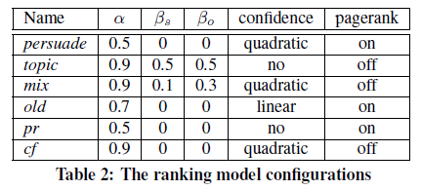
Experiment - Model configuration
Persuade : aims at high persuasiveness by ignoring any entity occurrences
Topic: aims at on-topicness by focusing totally on the entity occurrences
pagerank (pr) : rely on pagerank
Confidence (cf ) : rely on pattern confidence

Slide 17
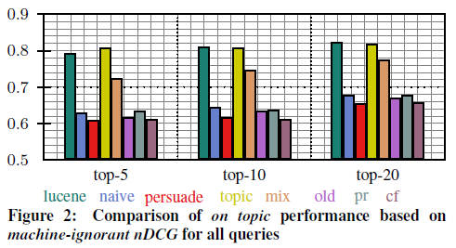
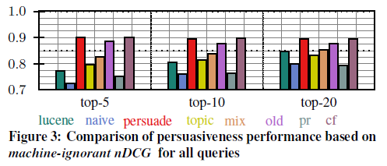

Slide 18
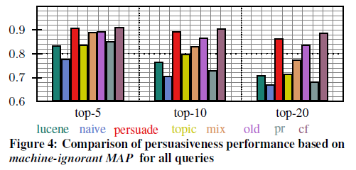

Slide 19
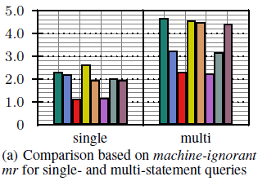
Query = { ( Barack Obama ,bornIn, Kenya ) }
Query = { (JFK, diedIn, Dallas),
(JFK, diedOn, 1963-11-22) }

Slide 20
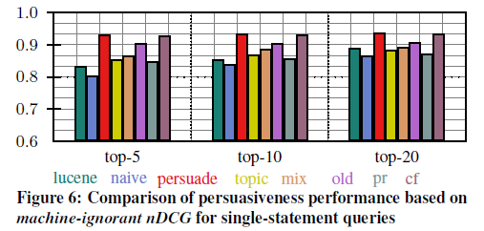
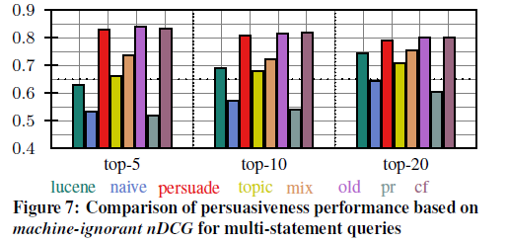
Query = { ( Barack Obama ,bornIn, Kenya ) }
Query = { (JFK, diedIn, Dallas),
(JFK, diedOn, 1963-11-22) }

Slide 21
Experiment
Compared to a purely keyword-based retrieval approach, that is not aware of any statement indication found by the extraction engine.

Slide 22
Conclusion
Notion of statement search and presented a framework implementing it.
Given a phrase query, the proposed framework maps it to a factual statement and retrieves documents containing textual expressions supporting the queried statement(s).
Evaluation results show that ranking model outperforms term-based document ranking in finding strongly supportive documents.

Slide 23
MAP(Mean Average Precision)
Topic 1 : There are 4 relative document ‧ rank : 1, 2, 4, 7
Topic 2 : There are 5 relative document ‧ rank : 1, 3 ,5 ,7 ,10
Topic 1 Average Precision : (1/1+2/2+3/4+4/7)/4=0.83。
Topic 2 Average Precision : (1/1+2/3+3/5+4/7+5/10)/5=0.45。
MAP= (0.83+0.45)/2=0.64。
Reciprocal Rank
Topic 1 Reciprocal Rank : (1+1/2+1/4+1/7)/4=0.473。
Topic 2 Reciprocal Rank : (1+1/3+1/5+1/7+1/10)/5=0.354。
MRR= (0.473+0.354)/2=0.4135。

Slide 24
NDCG(Normalized Discounted Cumulative Gain)
relevance scale with three grades (non-relevant, somewhat relevant, highly relevant)
Topic 1 : There are 4 relative document, D2,D1,D3,D4 = ( 2,2,1,1 )
rank : D1,D4,D2,D3 = ( 2,1,2,1 ) ‧ rank : 1, 2, 4, 7
Topic 2 : There are 5 relative document , D2,D1,D5,D3,D4 = (2,2,1,1,1)
rank : D5,D4,D3, D2,D1, = ( 1,1,1,2,2 ) ‧ rank : 1, 3 ,5 ,7 ,10
Topic 1 NDCG = 【2/log₂(2) + 1/log₂(3) + 2/log₂(5) + 1/log₂(8)】/
【2/log₂(2) + 2/log₂(3) + 1/log₂(4) + 1/log₂(5)】
Topic 2 NDCG = 【 1/ log₂(2) + 1/ log₂(4) + 1/ log₂(6) + 2/ log₂(8) + 2/ log₂(11) 】/【2/ log₂(2) + 2/ log₂(3) + 1/ log₂(4) + 1/ log₂(5) + 1/ log₂ (6) 】

